Slide 1


Amazon Sales Analysis
Project by: Mohammed Azharuddin

Slide 2
Project Overview
Analyzed over 21,000 sales records from an Amazon-like e-commerce platform using MySQL.
Studied customer behavior, product performance, and sales trends through SQL queries.
Solved real-world problems like revenue analysis, customer segmentation, and inventory management.
Worked on data cleaning, including fixing errors and handling missing (null) values.
Used structured queries in MySQL to gain insights and support business decisions.
Summary
This project focuses on solving 22 advanced business problems related to Amazon sales optimization.
By leveraging SQL queries, we aim to uncover valuable insights that can enhance sales performance,
improve inventory management, and optimize overall business operations.

Slide 3

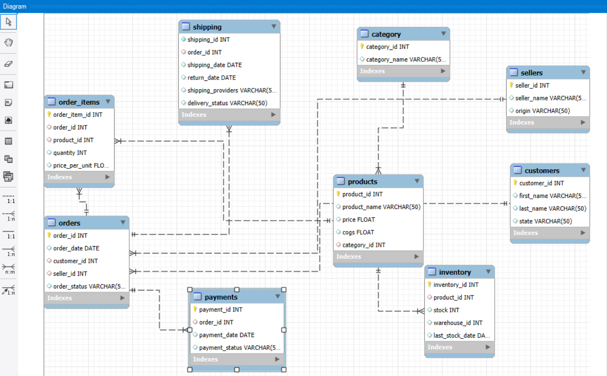
Schema Design

Slide 4
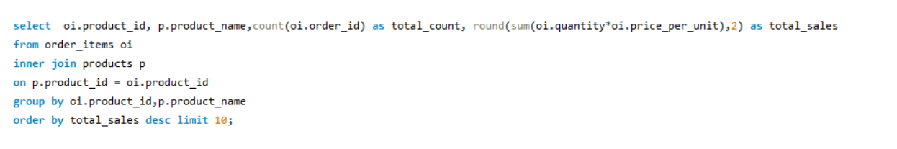
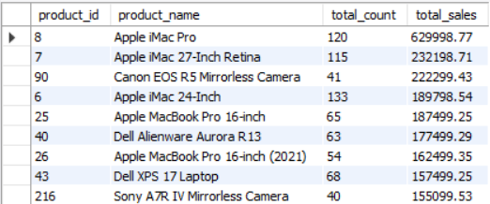
Solving Business Problems
Top Selling Products
Query the top 10 products by total sales value.
Challenge: Include product name, total quantity sold, and total sales value.

Slide 5
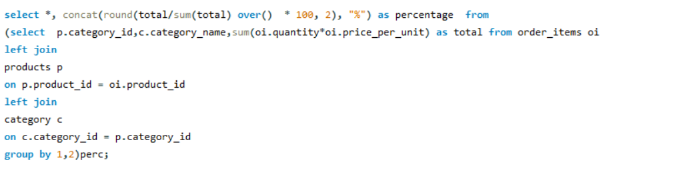
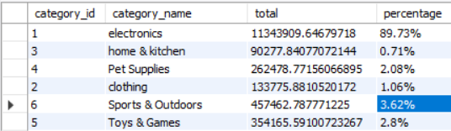
2. Revenue by Category
Calculate total revenue generated by each product category.
Challenge: Include the percentage contribution of each category to total revenue.

Slide 6
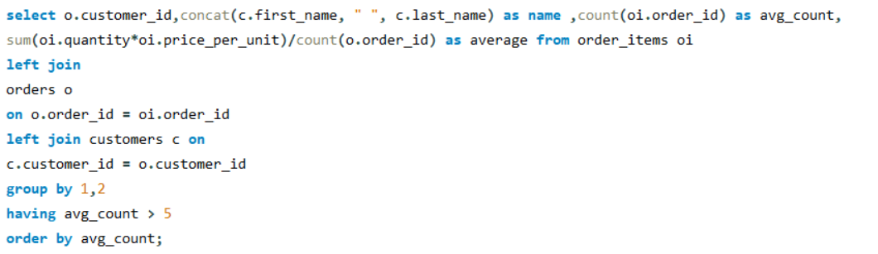
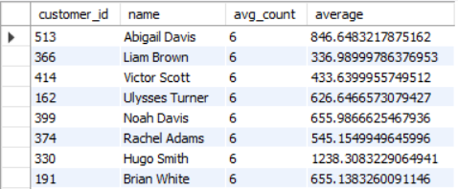
3. Average Order Value (AOV)
Compute the average order value for each customer.
Challenge: Include only customers with more than 5 orders.

Slide 7
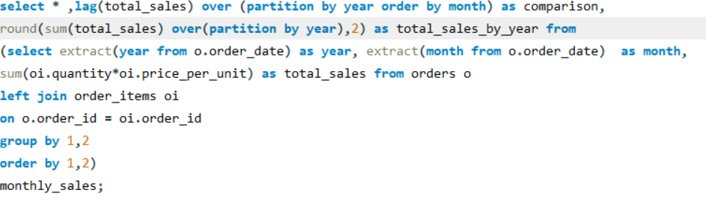
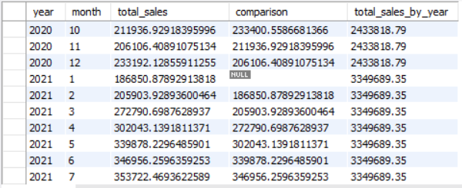
4. Monthly Sales Trend
Query monthly total sales over the past year.
Challenge: Display the sales trend, grouping by month, return current month sale, last month sale!

Slide 8
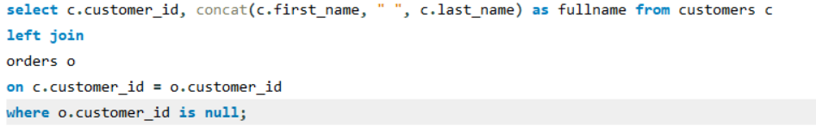
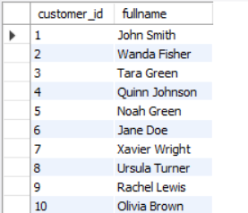
5. Customers with No Purchases
Find customers who have registered but never placed an order.
Challenge: List customer details and the time since their registration.

Slide 9
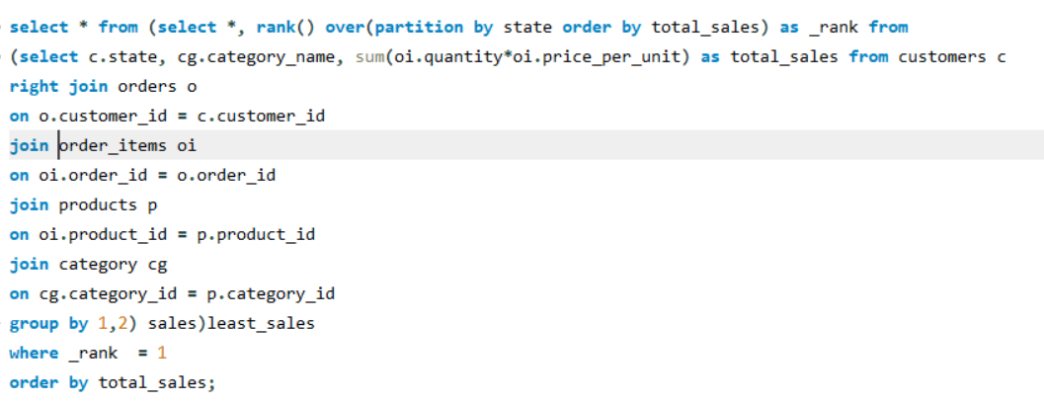
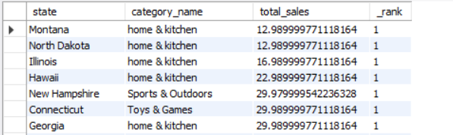
6. Least-Selling Categories by State
Query: Identify the least-selling product category for each state.
Challenge: Include the total sales for that category within each state.

Slide 10
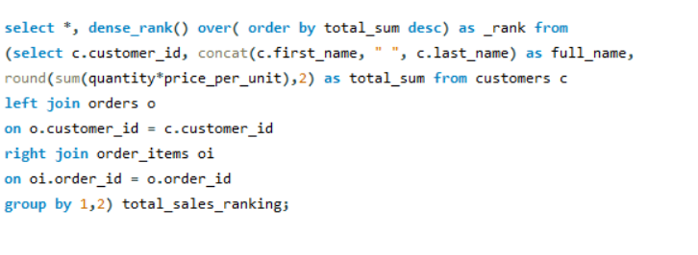
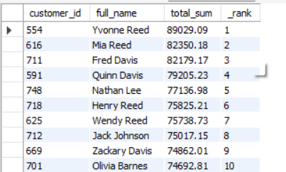
7. Customer Lifetime Value (CLTV)
Query: Calculate the total value of orders placed by each customer over their lifetime.
Challenge: Rank customers based on their CLTV.

Slide 11
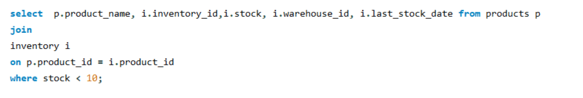
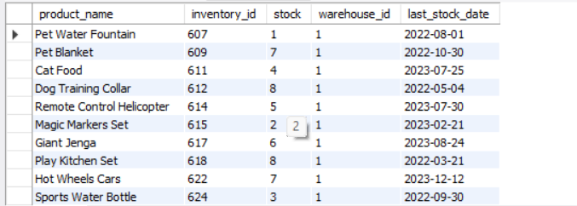
8. Inventory Stock Alerts Query:
Products with stock levels below a certain threshold (e.g., less than 10 units).Challenge:
Include last restock date and warehouse information.

Slide 12
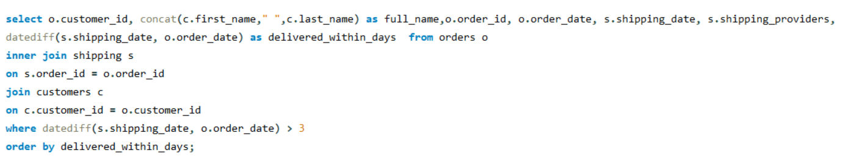
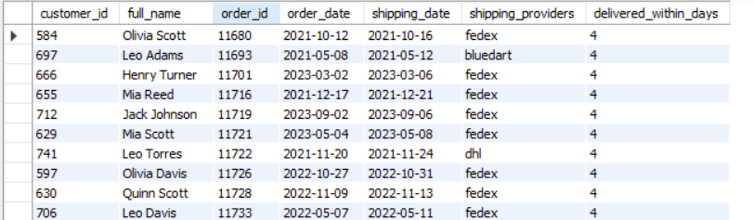
9. Shipping Delays Query:
Identify orders where the shipping date is later than 3 days after the order date.
Challenge: Include customer, order details, and delivery provider.

Slide 13
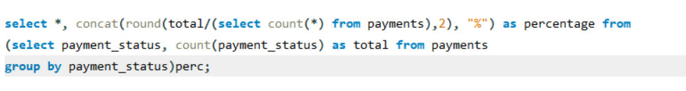
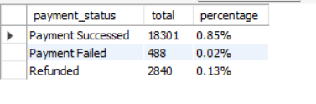
10. Payment Success Rate
Calculate the percentage of successful payments across all orders.
Challenge: Include breakdowns by payment status (e.g., failed, pending).

Slide 14
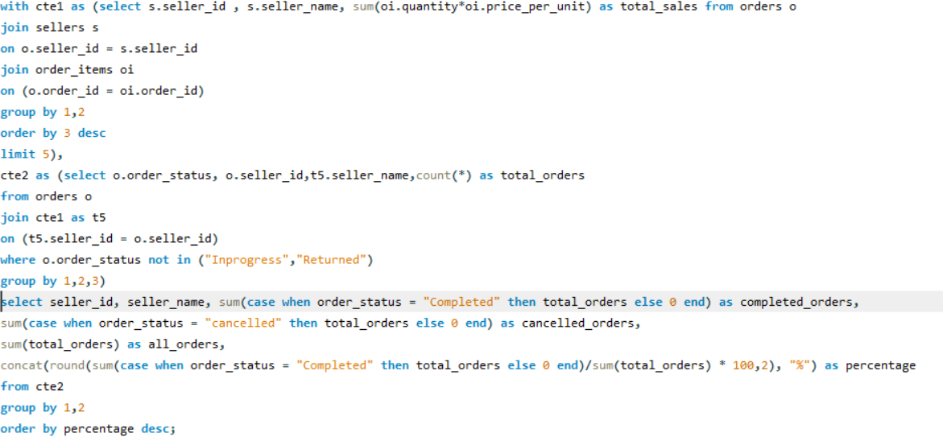
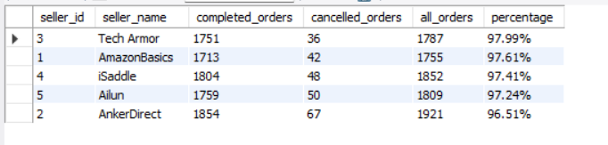
11. Top Performing Sellers Query:
Find the top 5 sellers based on total sales value.
Challenge: Include both successful and failed orders, and display their percentage of successful orders.

Slide 15
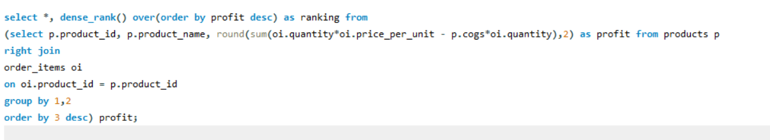
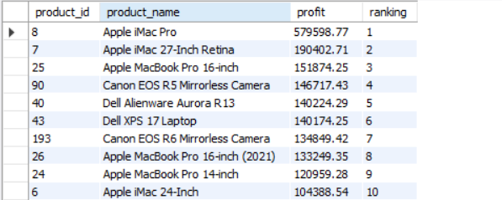
12. Product Profit Margin Query:
Calculate the profit margin for each product (difference between price and cost of goods sold).Challenge: Rank products by their profit margin, showing highest to lowest.

Slide 16
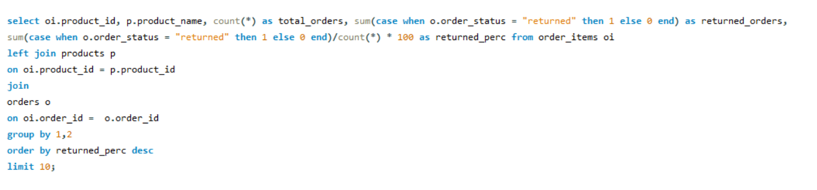
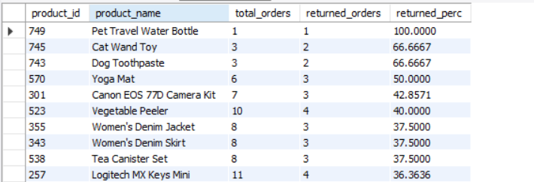
13. Most Returned Products Query:
Top 10 products by the number of returns.
Challenge: Display the return rate as a percentage of total units sold for each product.

Slide 17
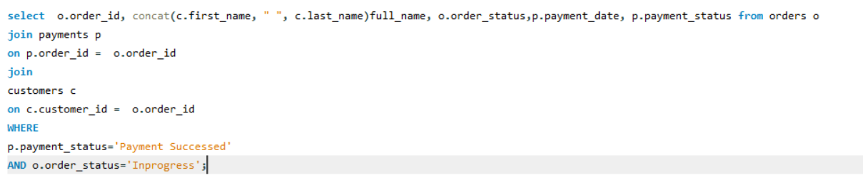
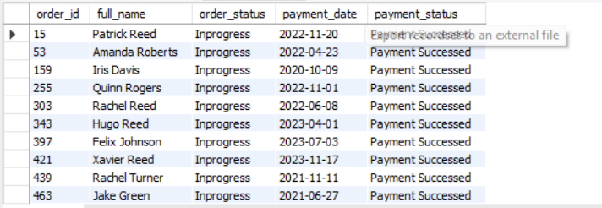
14. Orders Pending Shipment :
Find orders that have been paid but are still pending shipment.
Challenge: Include order details, payment date, and customer information.

Slide 18
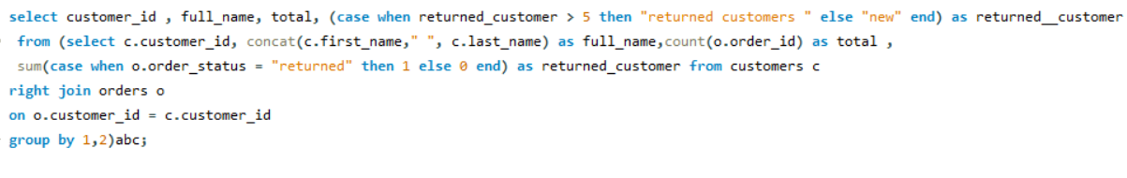
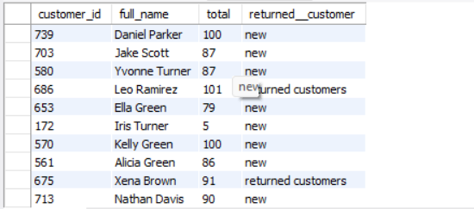
15. Identify Returning or New Customers
if the customer has done more than 5 return categorize them as returning otherwise new
Challenge: List customers id, name, total orders, total returns

Slide 19
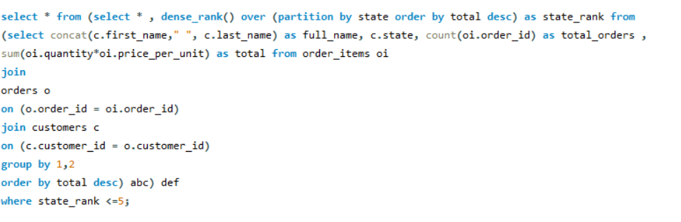
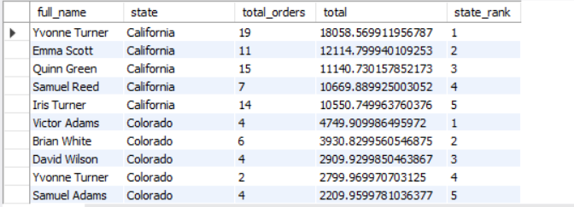
16. Top 5 Customers by Orders in Each State
Identify the top 5 customers with the highest number of orders for each state.
Challenge: Include the number of orders and total sales for each customer.

Slide 20
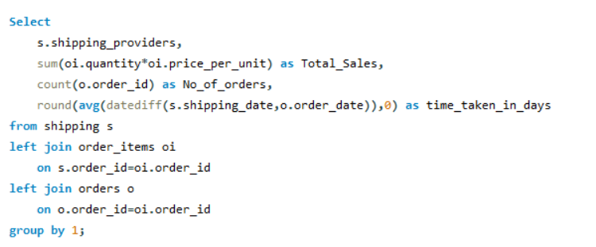
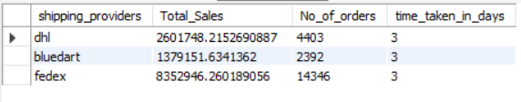
17. Revenue by Shipping Provider
Query: Calculate the total revenue handled by each shipping provider.
Challenge: Include the total number of orders handled and the average delivery time for each provider.

Slide 21
Learning Outcomes
Through this project, I was able to Create and set up a well-structured (normalized) database design.
Clean and prepare real-world data for analysis.
Apply advanced MYSQL skills like using window functions, joins, and subqueries.
Perform detailed business analysis using SQL queries.
Improve query performance and work effectively with large amounts of data.
Conclusion
This advanced SQL project shows my ability to solve real-world e-commerce challenges using structured queries. It covers important areas like improving customer retention, managing inventory, and streamlining logistics by using data-driven insights.
Completing this project helped me understand how SQL can be used to handle complex data problems and support smart business decisions.

Slide 22

Thank You

